Slide 1
Decision-making process in the organization

Slide 2

Decision-making process in the organization
The nature of decision making
Decision-making procedures
Behavioral aspects of decision making
Types of decisions and decision support tools
Source: www.benchen.org.pl
Notes:
Decision making process - the foundation of all management activities.

Slide 3

The nature of decision making
Decision making: the act of choosing one alternative from among a set of alternatives.
Decision-making process = the act of choosing one alternative from among multiply alternatives
Source: www.millvalleyshop.com

Slide 4
Types of decisions
Programmed decision - a decision that is
relatively structured or recurs with some
frequency (or both).
Nonprogrammed decision - a decision that is
relatively unstructured and occurs much less
often than a programmed decision.
Notes:
Programmed decision - a decision that is relatively structured or recurs with some frequency. Many decisions regarding standard transactions and basic systems and procedures belong to this category. For example, a BMW dealer decided to support the youth soccer team every year. So when the club president calls him, he knows what to do.
Unprogrammed decision - a decision that is relatively unstructured and occurs much less often than a programmed decision.
They are treated as unique, consuming a lot of time, energy and resources. You need intuition and experience to take them. Unprogrammed decisions are usually decisions taken by top managers regarding strategies (mergers, acquisitions), organization design, new plants, new products, collective agreements, and legal problems.

Slide 5
Decision-making process
Decision-making conditions:
State of certainty
State of risk
State of uncertainty

Slide 6

State of certainty
A condition in which the decision maker knows with reasonable certainty what the alternatives are and what conditions are associated with each alternative.
Source: www.otorowski.com

Slide 7

State of risk
A condition in which the availability of each alternative and its potential payoffs and costs are all associated with probability estimates.
Sources: weblogs.newsday.com
Notes:
Suppose, for example, that a labor contract negotiator for a company receives a “final” offer from the union right before a strike deadline. The negotiator will have two alternatives: to accept or to reject the offer. The risk centers on whether the union representatives are bluffing. If the company negotiator accepts the offer, she avoids a strike but commits to a relatively costly labor contract. If she rejects the contract, she may get a more favorable contract if the union is bluffing, but she may provoke a strike if it is not.
On the basis of past experiences, relevant information, the advice of others, and her own judgment, she may conclude that there is about a 75 percent chance that union representatives are bluffing and about a 25 percent chance that they will back up their threats. Thus, she can base a calculated decision on the two alternatives (accept or reject the contract demands) and the probable consequences of each. When making decisions under a state of risk, managers must reasonably estimate the probabilities associated with each alternative. For example, if the union negotiators are committed to a strike if their
demands are not met, and the company negotiator rejects their demands because she guesses they will not strike, her miscalculation will prove costly. [Griffin]

Slide 8

State of uncertainty
A condition in which the decision maker does not know all the alternatives, the risks
associated with each, or the likely consequences of each alternative.
Source: https://thinkimmigration.org/blog/2018/12/05/proposed-h-1b-policy-creates-new-uncertainty-for-american-employers/
Notes:
Most of the major decision making in contemporary organizations is done under a state of uncertainty. Intuition, judgment, and experience always play major roles in the decision-making process under conditions of uncertainty.

Slide 9
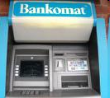
Decision-making process
Algorithmic process
Algorithm
Heuristic methods
Heuristics - a scientific discipline dealing with methods of solving problems in conditions of incomplete information, which is compensated by intuition and experience.
Source: stevepyfrom.blogspot.com
Notes:
An algorithm is a step by step method of solving a problem. Or: is a procedure or formula for solving a problem, based on conducting a sequence of specified actions. Algorithmic process - a decision-making process in which all its stages are defined. Algorithm (a set of rules of operation, specifying how to solve a given problem in a finite number of steps, e.g. withdrawing money from an ATM) - the way it is implemented. Heuristic methods - methods of creative thinking, methods of incomplete information. They need the ability to detect facts and relationships between them. Most of the discoveries and inventions were achieved thanks to heuristic methods of solving problems.

Slide 10
The Classical (Normative) Model of Decision Making
Assumption: managers are logical and rational and that they make decisions that are in the organization’s best interests.
• obtain complete
and perfect information
• eliminate uncertainty
• evaluate everything
rationally and logically
When faced with a
decision situation,
managers
should . . .
. . and end up with
a decision that best
serves the interests
of the organization.

Slide 11
Steps in the Rational Decision-Making Process
Step 1. Recognizing and defining the decision situation
Step 2. Identifying alternatives
Step 3. Evaluating alternatives
Step 4. Selecting the best alternative
Step 5. Verification of the recommended solution/correcting the solution
Step 6. Implementing the chosen alternative
Step 7. Following up and evaluating the results
Step 8. Reengineering

Slide 12
Behavioral aspects of decision- making
Administrative model:
When faced with a
decision situation
managers actually . . .
• use incomplete and
imperfect information
• are constrained by
bounded rationality
• tend to satisfice
. . . and end up with a
decision that may or may
not serve the interests
of the organization.
Notes:
Herbert A. Simon was one of the first experts to recognize that decisions are not always made with rationality and logic. Simon was subsequently awarded the Nobel Prize in Economics. Rather than prescribing how decisions should be made, his view of decision making, now called the administrative model, describes how decisions often actually are made. The model holds that decision makers (1) use incomplete and imperfect information, (2) are constrained by bounded rationality, and (3) tend to “satisfice” when making decisions.

Slide 13


Behavioral aspects of decision- making
Bounded rationality
Satisficing
Coalition
Intuition
Escalation of commitment
Risk propensity
Ethics
Group and team decision making
Sources: cruise1travel.blogspot.com, wrzuta.blox.pl
Notes:
Bounded rationality suggests that decision makers are limited by their values and unconscious reflexes, skills, and habits. They are also limited by less-than-complete information and knowledge. Bounded rationality partially explains how U.S. auto executives allowed Japanese automakers to get such a strong foothold in the U.S. domestic market. For years, executives at GM, Ford, and Chrysler compared their companies’ performance only to one another’s and essentially ignored foreign imports. The foreign “threat” was not acknowledged until the domestic auto market had been changed forever. If managers had gathered—and acknowledged—complete information from the beginning, they might have been better able to thwart foreign competitors.
Satisficing - the tendency to search for alternatives only until one is found that meets some minimum standard of sufficiency.
Coalition - an informal alliance of individuals or groups formed to achieve a common goal.
Intuition - an innate belief about something, without conscious consideration.
Escalation of commitment - when a decision maker stays with a decision even when it appears to be wrong.
Risk propensity - the extent to which a decision maker is willing to gamble when making a decision.

Slide 14
Group and team decision-making
Interacting group or team - a decision-making group or team in which members openly discuss, argue about, and agree on the best alternative.
Nominal group - a structured technique used to generate creative and innovative alternatives or ideas.
Notes:
Nominal Groups Another useful group and team decision-making technique that is occasionally used is the nominal group. Unlike the Delphi method, in which group members do not see one another, nominal group members are brought together in a face-to-face setting. The members represent a group in name only, however; they do not talk to one another freely like the members of interacting groups. Nominal groups are used most often to generate creative and innovative alternatives or ideas. To begin, the manager assembles a group of knowledgeable experts and outlines the problem to them. The group members are then asked to individually write down as many alternatives as they can think of. The members then take turns stating their ideas, which are
recorded on a flip chart or board at the front of the room. Discussion is limited to simple clarification. After all alternatives have been listed, more open discussion takes place. Group members then vote, usually by rank, ordering the various alternatives. The highest-ranking alternative represents the decision of the group. Of course, the manager in charge may retain the authority to accept or reject the group decision

Slide 15
Group and team decision-making
Advantages ☺:
More information and knowledge are available
More alternatives are likely to be generated
More acceptance of the final decision is likely
Enhanced communication of the decision may result
Better decisions generally emerge
Disadvantages ☹:
The process takes longer than individual decision making, so it is costlier
Compromise decisions resulting from indecisiveness may emerge
One person may dominate the group
Groupthink may occur

Slide 16

Group and team decision-making
Groupthink:
a situation that occurs when a group or team’s desire for consensus and cohesiveness overwhelms its desire to reach the best possible decision
Source: www.bbc.co.uk
Notes:
One of the most clearly documented examples of groupthink involved the space shuttle Challenger disaster. As NASA was preparing to launch the shuttle, numerous problems and questions arose. At each step of the way, however, decision makers argued that there was no reason to delay and that everything
would be fine. Shortly after its launch, the shuttle exploded, killing all seven crew members.

Slide 17
Groupthink ☹
Senatores boni viri, senatus autem mala bestia
Illusions of invulnerability lead members of the group to be overly optimistic and engage in risk-taking.
Unquestioned beliefs lead members to ignore possible moral problems and ignore the consequences of individual and group actions.
Rationalizing prevents members from reconsidering their beliefs and causes them to ignore warning signs.
Stereotyping leads members of the in-group to ignore or even demonize out-group members who may oppose or challenge the group's ideas.
Notes:
Senators are good men, but the Senate as a whole is a beast (Latin)

Slide 18
Groupthink ☹
Self-censorship causes people who might have doubts to hide their fears or misgivings.
"Mindguards" act as self-appointed censors to hide problematic information from the group.
Illusions of unanimity lead members to believe that everyone is in agreement and feels the same way.
Direct pressure to conform is often placed on members who pose questions, and those who question the group are often seen as disloyal
Notes:
A mindguard is a member of a group who serves as an informational filter, providing limited information to the group and, consciously or subconsciously, utilizing a variety of strategies to control dissent and to direct the decision-making process toward a specific, limited range of possibilities.

Slide 19
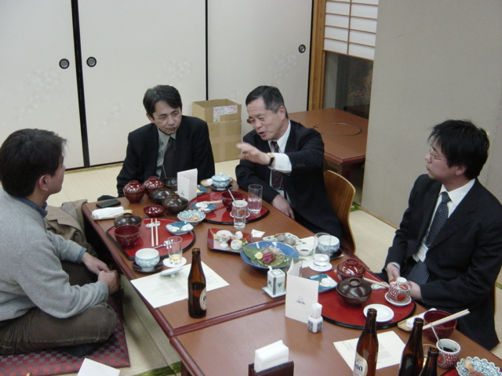
Group and team decision making
Japanese style of decision making?

Slide 20
Group and team decision-making
Japanese style of decision making – ringisei
A long process
No one is allowed to take a definitive position on the final solution (threat of face loss)
No open debate, no polarization of positions, no division into 'losers' and 'winners'
After finding the final solution – immediate and quick implementation

Slide 21
Group and team decision-making
Management of group and team decision making processes:
The manager should set up a deadline
The manager should wisely select the group members (either without the dominant person, or with several equally strong personalities)
The manager should not reveal his/her views too early
Advocatus diaboli

Slide 22
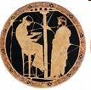
Heuristic approach
Delphi group
A form of group decision making in which a group arrives at a consensus of expert opinion
Source: www.kb.neostrada.pl
Notes:
Delphi Groups. A Delphi group is sometimes used to arrive at a consensus of expert opinion. Developed by the Rand Corporation, the Delphi procedure solicits input from a panel of experts who contribute individually. Their opinions are combined and, in effect, averaged. The experts do not see each other.

Slide 23


Decision support tools
Optimization models – based on mathematical theory of decisions and operations research.
Simulation models
Econometrics – quantitative application of statistical and mathematical models using data to develop theories or test existing hypotheses in economics and to forecast future trends from historical data.
?
Sources: www.arundelhousehotels.co.uk, www.adax.pl

Slide 24
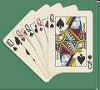
Decision support tools
Decision games – examples:
Two-person zero sum games (non-cooperative games)
Cooperative games
Source: www.poker-tomorrow.com
Notes:
A game played by two rational players is called zero-sum if one player's gain is the other player's loss. Chess, Checker
Cooperative games are the one in which players are convinced to adopt a particular strategy through negotiations and agreements between players.

Slide 25
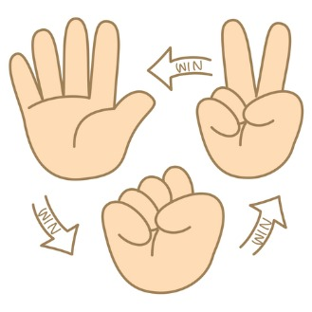
Non-cooperative game – an example
Rock-Paper-Scissors
Notes:
Rock-paper-scissors (also known as scissors-rock-paper and scissors-paper-stone) is a hand game usually played between two people, in which each player simultaneously forms one of three shapes with an outstretched hand. These shapes are "rock" (a closed fist), "paper" (a flat hand), and "scissors" (a fist with the index finger and middle finger extended, forming a V). "Scissors" is identical to the two-fingered V sign (also indicating "victory" or "peace") except that it is pointed horizontally instead of being held upright in the air. A simultaneous, zero-sum game, it has only two possible outcomes: a draw, or a win for one player and a loss for the other.
A player who decides to play rock will beat another player who has chosen scissors ("rock crushes scissors" or sometimes "blunts scissors"^{[1]}), but will lose to one who has played paper ("paper covers rock"); a play of paper will lose to a play of scissors ("scissors cuts paper"). If both players choose the same shape, the game is tied and is usually immediately replayed to break the tie. The type of game originated in China and spread with increased contact with East Asia, while developing different variants in signs over time. Other names for the game in the English-speaking world include roshambo and other orderings of the three items, with "rock" sometimes being called "stone".
Rock-paper-scissors is often used as a fair choosing method between two people, similar to coin flipping, drawing straws, or throwing dice in order to settle a dispute or make an unbiased group decision

Slide 26

Cooperative game – an example
The bargaining between buyer and seller over the
price of a rug. If the rug costs $100 to produce and the buyer values the rug at $200, a cooperative solution to the game is possible. An agreement to sell the rug at any price
between $101 and $199 will maximize the sum of the buyer’s consumer surplus and the seller’s profit while making both parties better off.

Slide 27
Decision support tools
Graphic models – examples:
Gantt charts:
tasks (horizontal lines)
parameters: duration, start and end date of the tasks
dependencies between tasks (vertical lines)
milestones
Notes:
Tasks – they are presented in the form of horizontal lines, and the length of every such line depends on the duration of the task execution.
Milestones are generally used to indicate important dates on the project plan, often key events or goals. For example, you might use milestones to mark desired completion dates, or project review meetings.

Slide 28
Gantt chart – an example
Period
Activity
J
F
M
A
M
J
J
Designing
Building
Testing

Slide 29
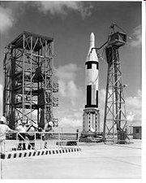

Decision support tools
Network planning techniques:
PERT (program evaluation and review technique)
CPM (critical path method)
Sources: pl.wikipedia.org/wiki/Okr%C4%99ty_podwodne_ty..., mbacasestudysolutions.com
Notes:
PERT and CPM are techniques of project management useful in the basic managerial functions of planning, scheduling and control. PERT stands for “Programme Evaluation & Review Technique” and CPM are the abbreviation for “Critical Path Method”. These days the projects undertaken by business houses are very large and take a number of years before commercial production can start. Program evaluation and review technique (PERT) and critical path method (CPM) date back to the 1950s. PERT was originally developed to plan and monitor the Polaris missile, an extremely large project using over 3000 contractors and involving thousands of activities. PERT is credited with reducing the project duration by two years. Because of its success, most government contracts still require the use of PERT or a similar technique. CPM was initially developed to plan and coordinate maintenance projects in chemical plants.
PERT is a sophisticated tool used in planning, scheduling and controlling large projects consisting of a number of activities independent of one another and with uncertain completion times. It is commonly used in research and development projects.
Critical path method (CPM): The critical path method is a step-by-step project management technique for process planning that identifies critical and noncritical tasks, preventing timeframe problems and process bottlenecks.

Slide 30
Critical path
A critical path is a sequence of interdependent activities or tasks that must be finished before the project can be finished. It is the longest path (i.e. path with the longest duration) from project start to finish. At the same time, the longest path is the path that shows the minimal time in which a project can be completed. If there is a delay in one activity of the path, the whole project will be delayed accordingly.

Slide 31
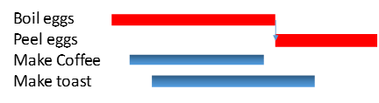
Breakfast ☺
Notes:
The critical path is a sequence of tasks that must be completed on schedule in order for the project to be completed on time. Let’s take making breakfast as an example. In this case, the scope of the project will be to deliver a hearty meal of coffee, toast and two boiled eggs. Such a project can be illustrated by means of a Gantt chart. The bars represent the length of time needed for each task. What we can see is that the breakfast will not be ready until the eggs are ready. All that egg work of boiling them and peeling them takes the longest time of any of the breakfast making tasks. Additionally, the acts of boiling and peeling the eggs must be done in series. We cannot peel the egg until it has been boiled. This sequence of tasks, the boiling and peeling, represent the critical path for the breakfast project. The addition of those two task durations determine the minimum overall project duration. The making of the coffee and toast are not critical path items. That means, It would be possible to delay or extend the making of either the coffee or toast and still have the breakfast ready on time.

Slide 32

Limitations of the use of decision support tools ☹
Human factor
Information factor
Economic barriers
Technical barriers
Organizational barriers
Socio-psychological barriers
Source: www.lfosn.org.pl
Notes:
The human factor - decision makers must be prepared to use modern planning techniques; if they do not have such qualifications, they will not apply them Information factor - you can slightly improve and organize the data and make decisions in the conditions of incomplete information, but, in general, "If you insert trash, you will get out trash."
Economic barriers - these tools are often expensive
Technical barriers - sometimes there is a lack of proper software or computers and databases
Organizational barriers - managers often do not have time to use quite labor-intensive tools; the company is not prepared organizationally Sociopsychological barriers - the manager has always made decisions intuitively and is unwilling to start using computer-based assessment methods
One more remark - the decision making process is difficult if, in practice, you don't really know who is responsible for what in the company. Then problems of coalition arise, etc.

